Slide 1
LinkedIn Endorsements: Reputation, Virality, and Social Tagging
O’Reilly Strata - February 28, 2013
Sam Shah @sam_shah
Pete Skomoroch @peteskomoroch

Slide 2


Sam Shah
Principal Engineer and Engineering Manager
@sam_shah
www.linkedin.com/in/shahsam
Peter Skomoroch
Principal Data Scientist
@peteskomoroch
www.linkedin.com/in/peterskomoroch

Slide 3
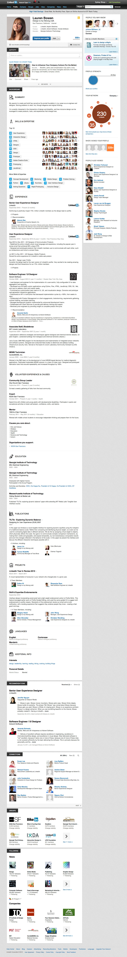
LinkedIn: The Professional Profile of Record
200+M
200M
Member
Profiles
Members

Slide 4
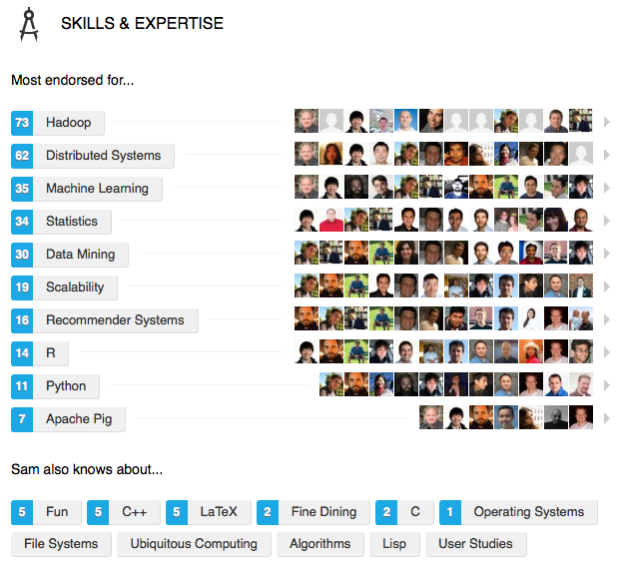
LinkedIn’s Latest Data Product: Skill Endorsements

Slide 5
Viral Growth: 800M Endorsements in 4 Months

Slide 6
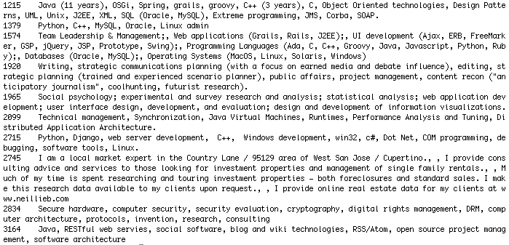
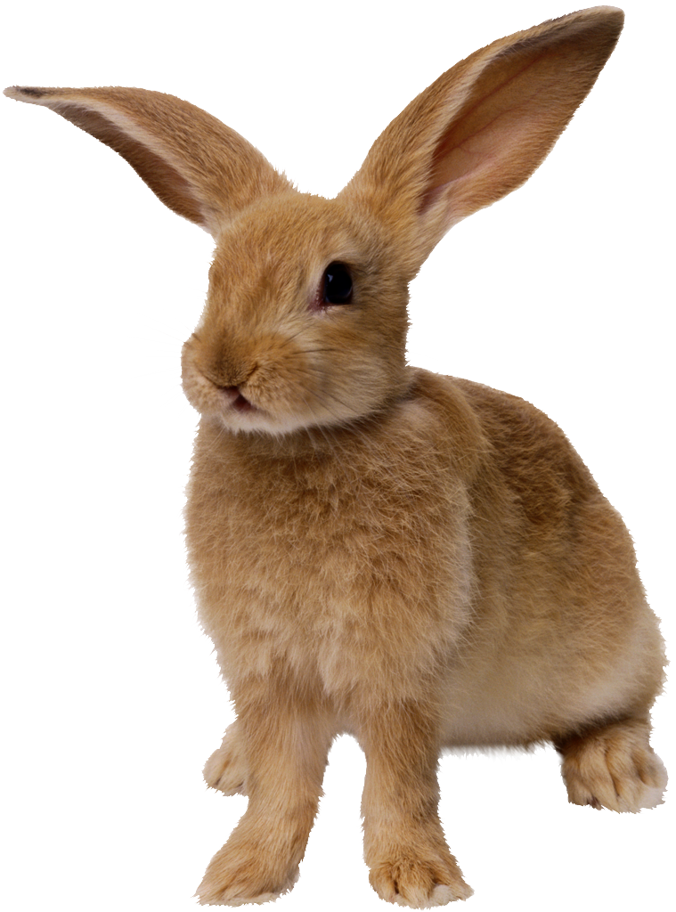
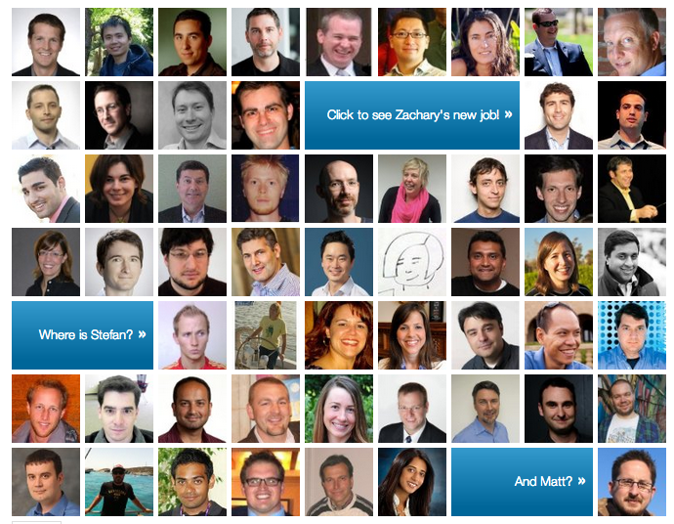
Data Amplifies Desire
Desire + Social Proof
Viral Loops + Network Effects
Data Foundation + Recommendation Algorithms

Slide 7
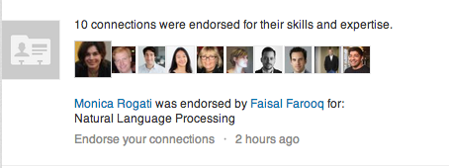
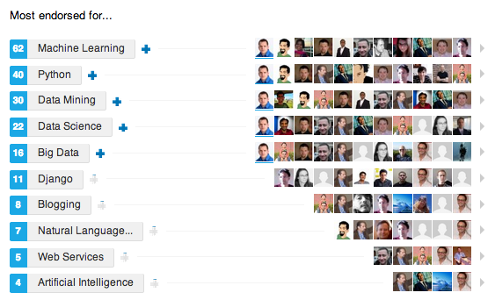
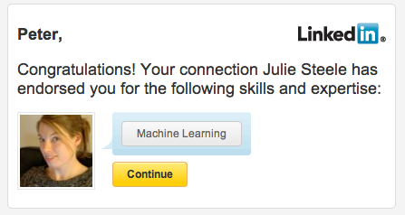
1) Desire & Social Proof

Slide 8
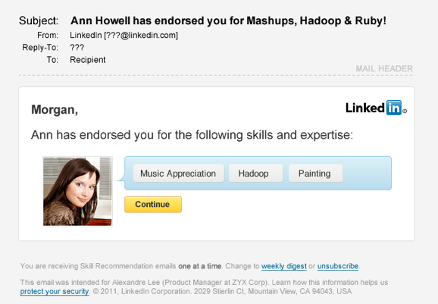
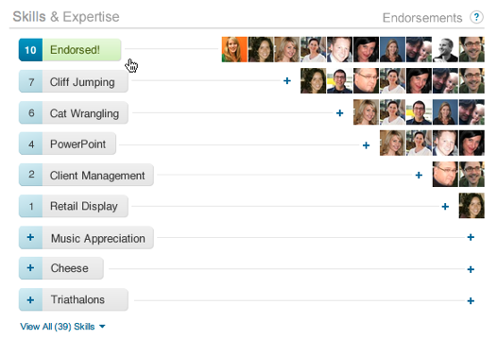
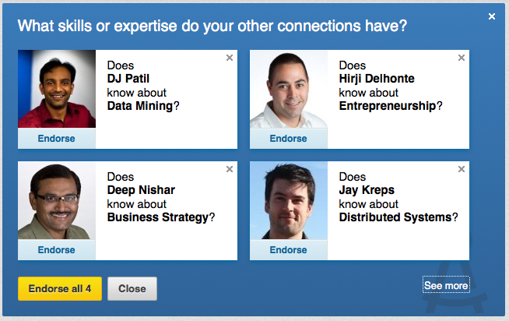
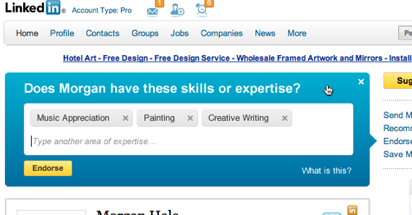
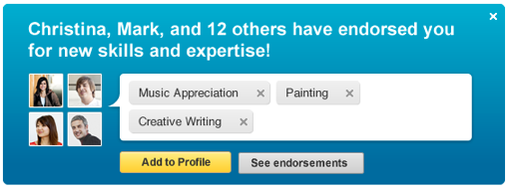
2) Viral Loops & Network Effects
Email
News Feed
Notification
A endorses B
B notified
B “accepts” endorsement
Endorsement recommendations
B endorses C
B endorses D

Slide 9
3) Data Foundation: Skills & Suggested Skills

Slide 10
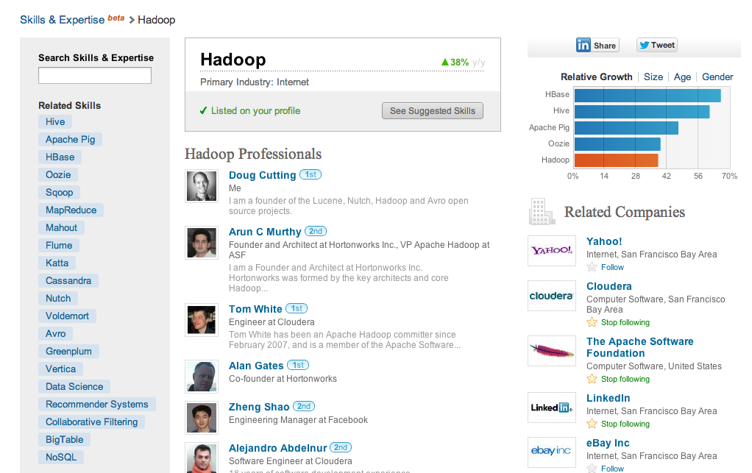
Data Foundation: LinkedIn Skills

Slide 11
Social Tagging Accelerates Adoption
Skill marketing
Skill recommendations
Virality only
Suggested endorsements

Slide 12
Outline
Skill discovery
Skill tagging
Skill recommendations
Suggested endorsements

Slide 13
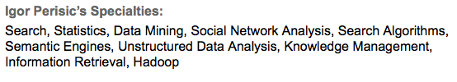

Unsupervised Topic Discovery from Profiles
Extract

Slide 14
Building the Skills Dictionary
Profile
(specialties)
What is the skills dictionary?
  A growing taxonomy of skills
  Generated by mining profiles and maintained by the Skills team at LinkedIn
  Created using clustering and crowdsourcing.
  Multiple phrases, acronyms, and misspellings map to a single standardized skill.
    250+ different phrases map to “Microsoft Office”
Tokenization
Clustering
Crowdsourcing
Taxonomy

Slide 15
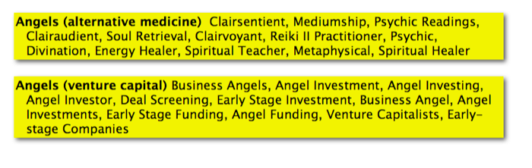
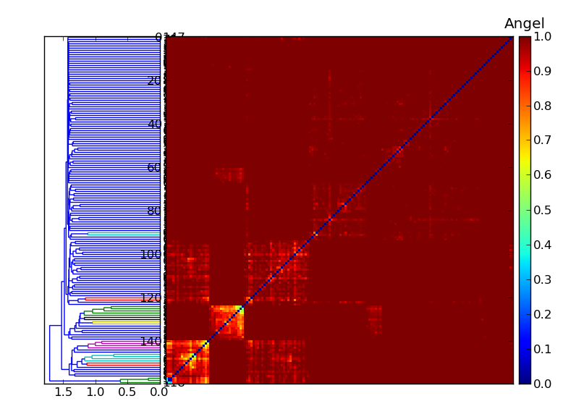
Topic Clustering & Phrase Sense Disambiguation

Slide 16
Skills Dictionary: Microsoft Office
  ms office
  ms office suite
  computer skills including ms office
  office 97
  microsoft office user
  mac office
  microsoft office 2003 & 2007
  microsoft office suits
  microsoft ofice
  microsoft ofiice
  ms office certified
  office 98
  …
Microsoft Office
(Skill ID = 366)

Slide 17
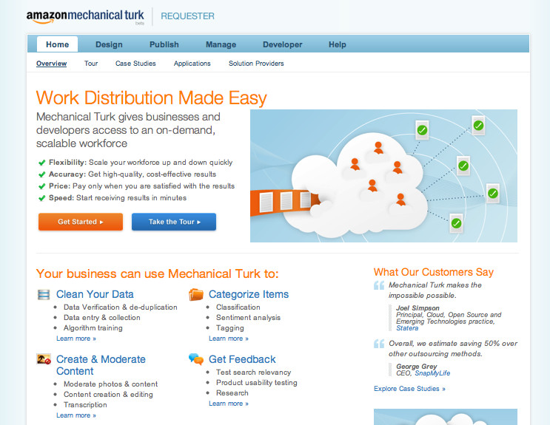
Deduplication Signals from Mechanical Turk

Slide 18
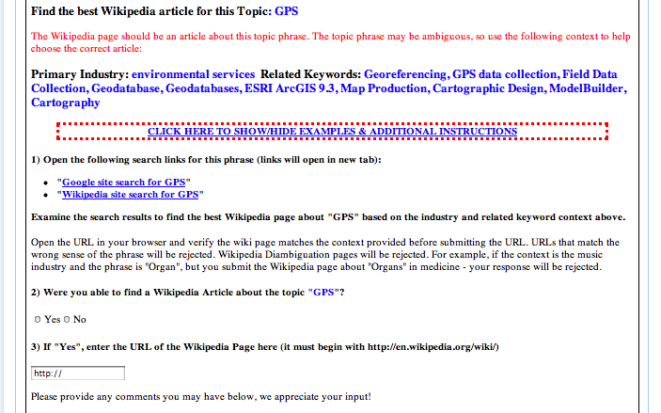
Sample Task for Mechanical Turk Workers

Slide 19
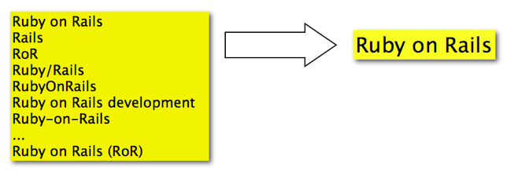
Skill Phrase Deduplication

Slide 20
Outline
Skill discovery
Skill tagging
Skill recommendations
Suggested endorsements

Slide 21
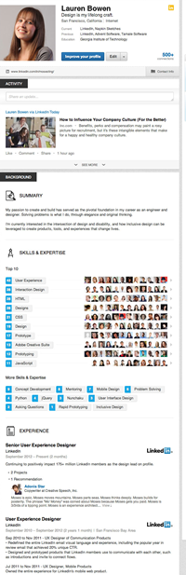
Skills Classification
Use skill dictionary metadata to tag, standardize and infer skills
Run classifiers for each skill on member profiles
Public Speaking
Ruby on Rails
Entrepreneurship
Microsoft Office
AP Style

Slide 22
Tagging Skill Phrases
Document (ex: Profile)
Tagging: Extract potential skill phrases from text
Standardize unambiguous phrase variants
Lead designer and engineer for the implementation of a user-centric, fully-configurable UI for data aggregation and reporting.
Developed over 20 SaaS custom applications using Python, Javascript and RoR.
Tokenization
Phrases
(up to 6 words)
JavaScript
RoR SaaS
Python
Skills Tagger
ror
rubyonrails
ruby on rails development
ruby rails
ruby on rail
Ruby on Rails
Skills
(unordered)
Skills Classifier
Skills
(ranked by relevance)

Slide 23
Outline
Skill discovery
Skill tagging
Skill recommendations
Suggested endorsements

Slide 24
Skills Classification on Member Profiles
  The skills classifier computes the likelihood of a member to have a skill based on the member’s profile, other profiles which share common attributes and their connections.
Tagging
Tokenize free
text into phrase tags
Standardization
Transform tags
into potential skills
Inference
Rank skills by
likelihood
Profile
text
Profile attributes & network signals

Slide 25
Skill Inference
Profile
How suggested/inferred skills work:
  Profiles with skills help build a massive dataset of (attribute: skills).
    Example with a title:
Extract attributes
Feature
Vectors
- Company ID
- Title ID
- Groups ID
- Industry ID
- …
Software Engineer Java 100 000
Software Engineer C++ 88 000
…
Skills Classifier
Title Skill Occurrences
Skills
(ranked by likelihood)

Slide 26

Skill Inference
Profile
How suggested/inferred skills work:
  The skill likelihood is a conditional model
  Probabilities are combined using a Naïve Bayes Classifier
If you are an engineer at Apple, you probably know about iPhone Development.
Extract attributes
Feature
Vectors
- Company ID
- Title ID
- Groups ID
- Industry ID
- …
Skills Classifier
Skills
(ranked by likelihood)

Slide 27
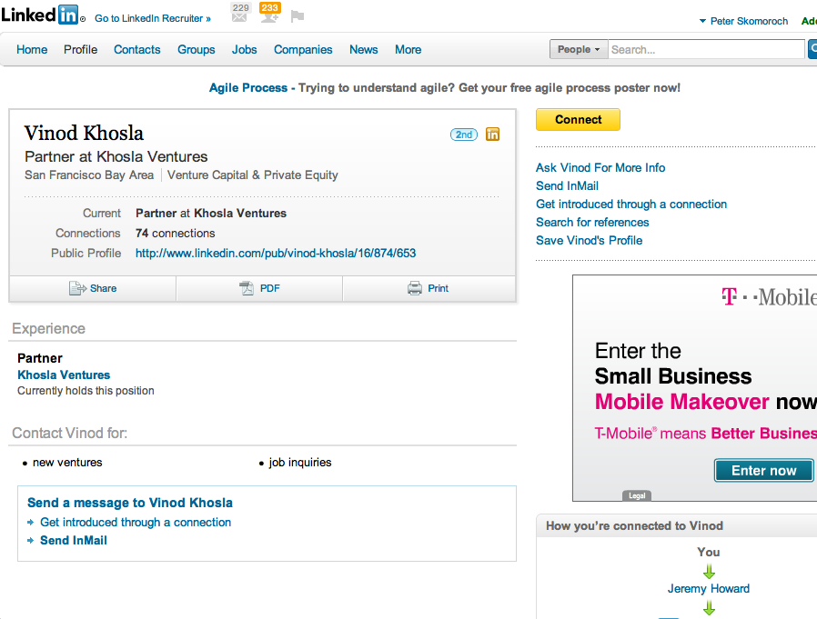

Slide 28
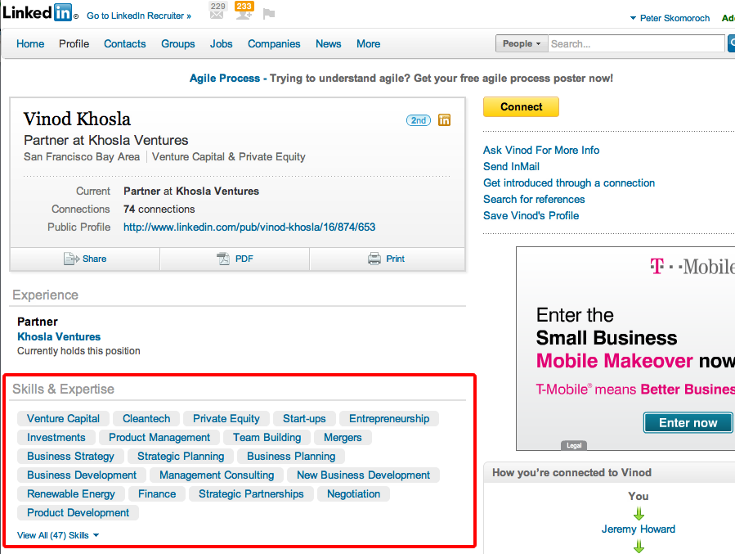

Slide 29
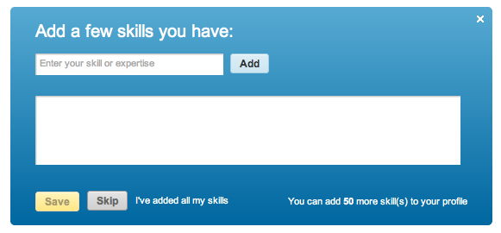
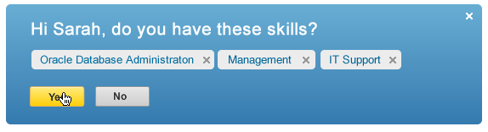
Skill Suggestions for Your LinkedIn Profile
4% Conversion
49% Conversion

Slide 30
Outline
Skill discovery
Skill tagging
Skill recommendations
Suggested endorsements

Slide 31
Social Tagging via Skill Endorsements

Slide 32
Suggesting Endorsements
Candidate
generation
People-skill combinations in a member’s network
Binary classification
Features
  Skill inference score
  Company overlap
  School overlap
  Group overlap
  Industry and functional area similarity
  Title similarity
  Site interactions
  Co-interactions
Feature
Vectors
- Company
- Title
- Groups
- Industry
- …
Classifier
Suggested Endorsements
(ranked by likelihood)

Slide 33
Social Tagging Accelerates Adoption
Skill marketing
Skill recommendations
Skill endorsements

Slide 34
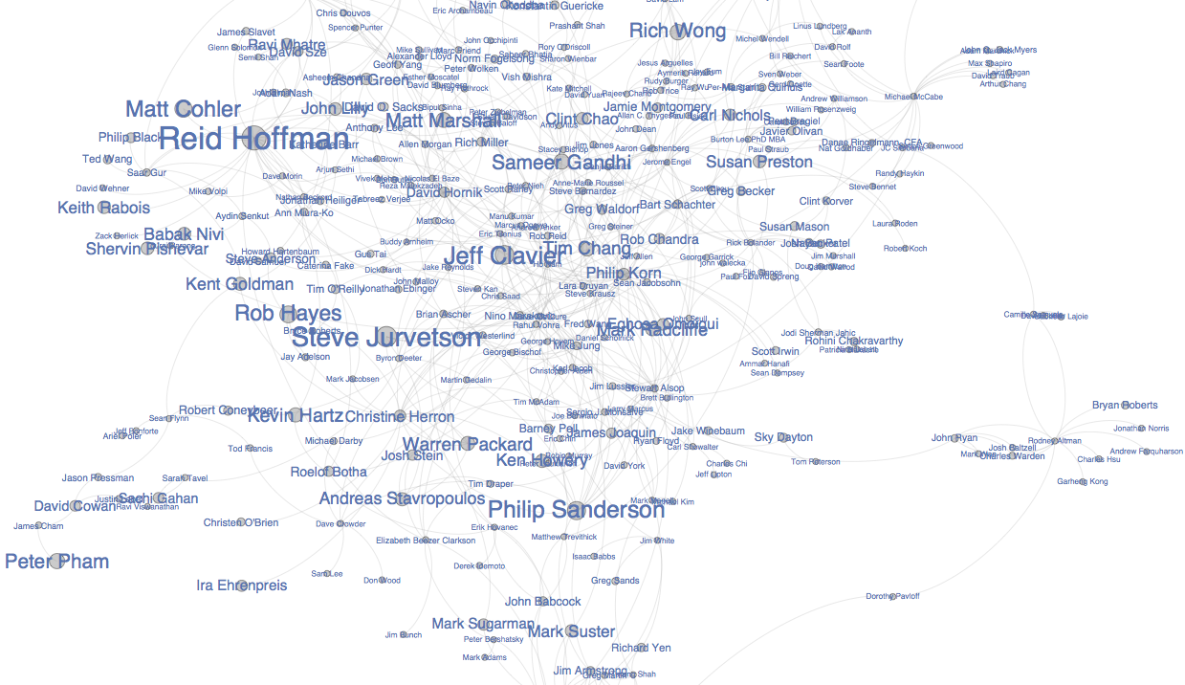
Can We Find Influencers In Venture Capital?

Slide 35
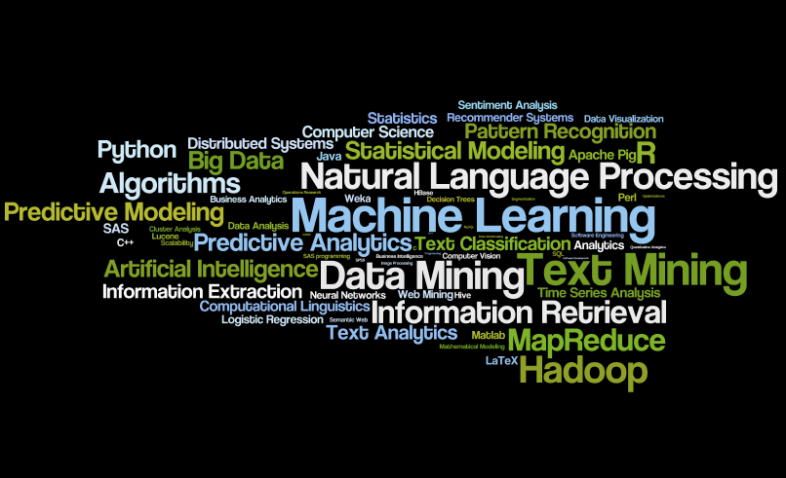
Which Skills Are Important for a Data Scientist?

Slide 36
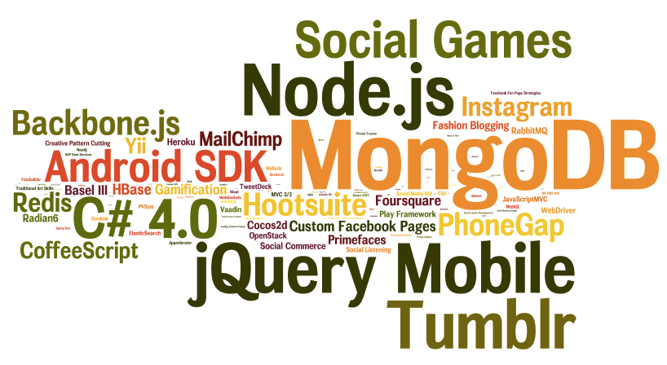
What Technologies are Professionals Adopting?

Slide 37
Data Amplifies Desire
Desire + Social Proof
Viral Loops + Network Effects
Data Catalyst + Recommendation Algorithms

Slide 38





Infrastructure
Apache Hadoop: Parallel processing architecture
Apache Kafka: Ingress pipes
Azkaban: Hadoop scheduler
Voldemort: Egress database
Apache Pig: High-level MR language
DataFu: Convenience routines
http://data.linkedin.com
R. Sumbaly, J. Kreps, and S. Shah. “The ‘Big Data’ ecosystem at LinkedIn”. In SIGMOD 2013 (to appear).

Slide 39
data.linkedin.com
Learning More

